Slide 1
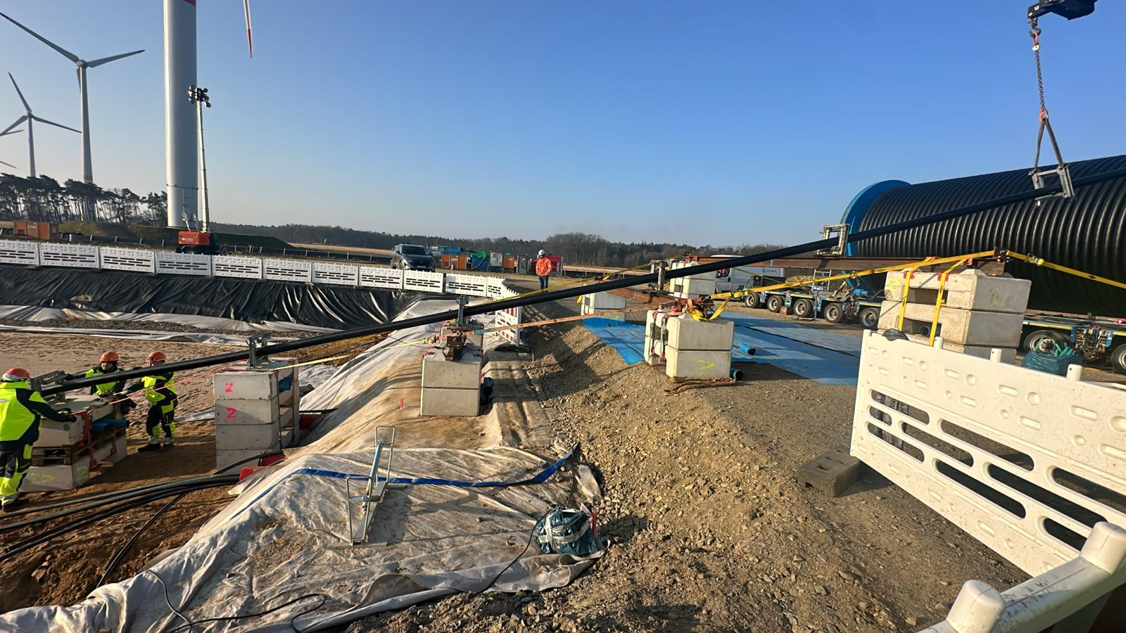
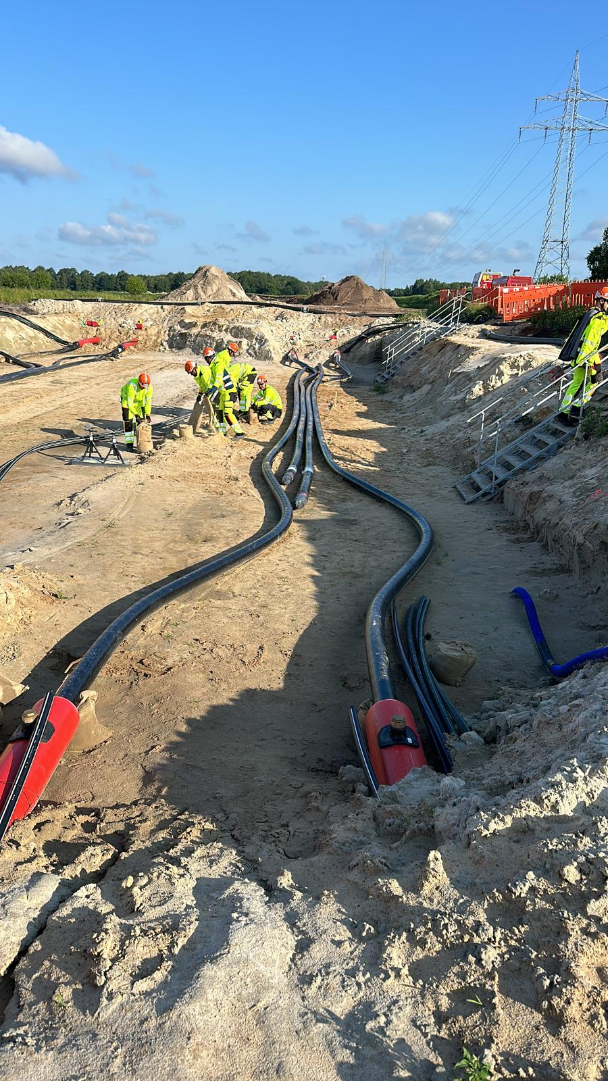
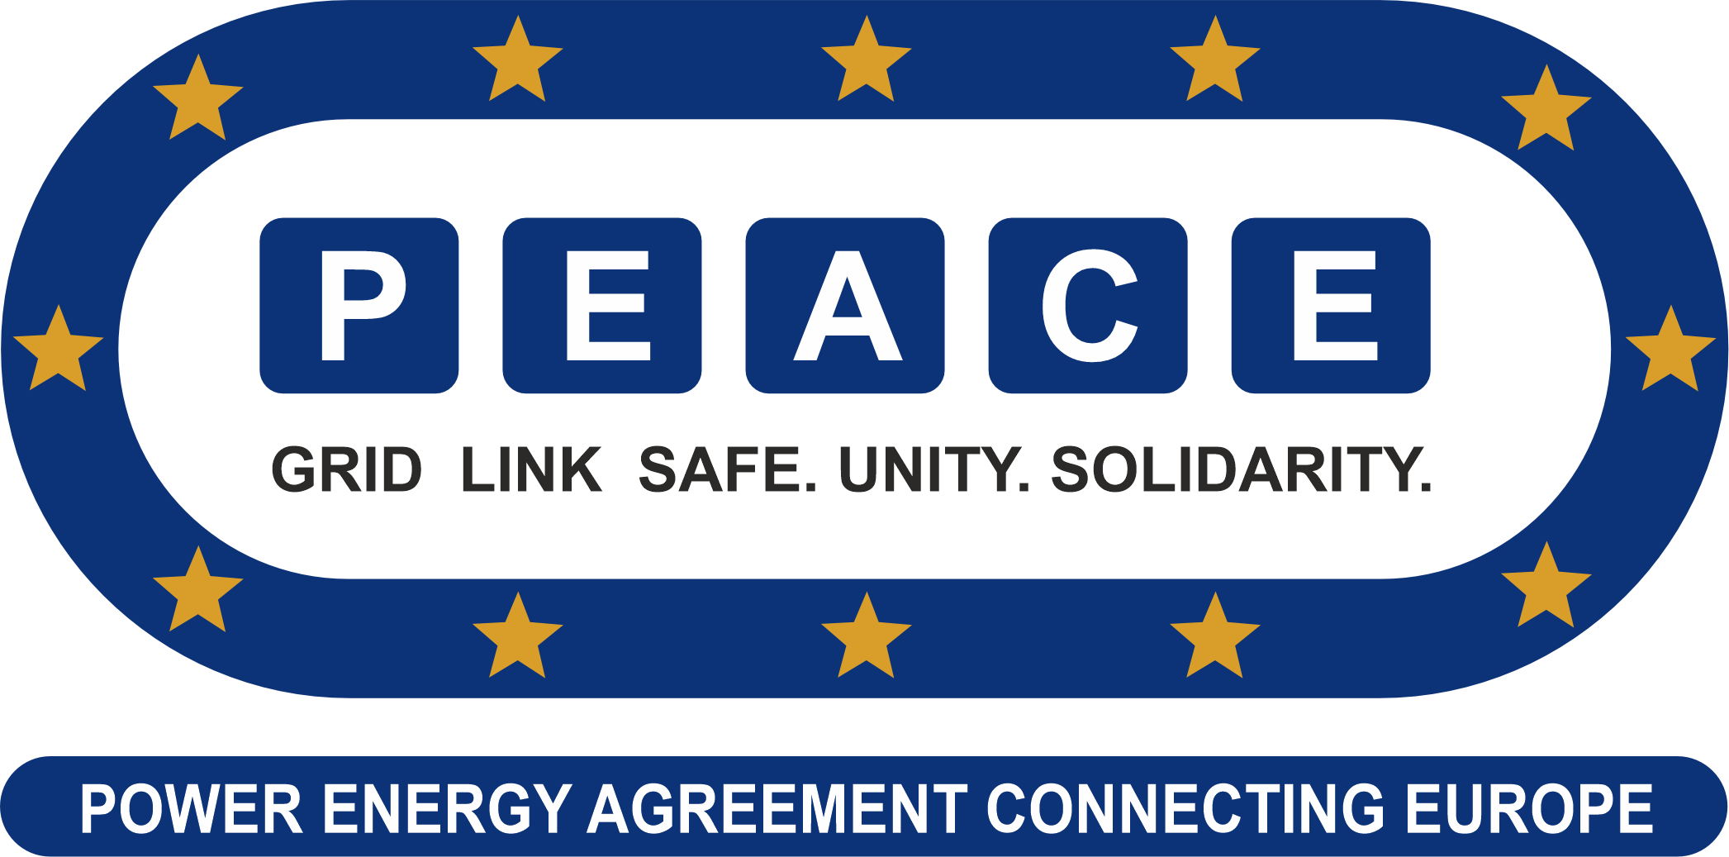
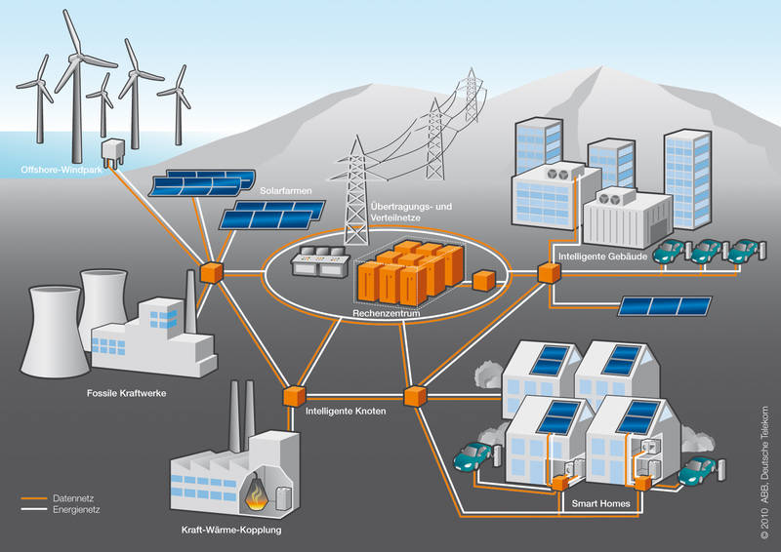

Slide 2

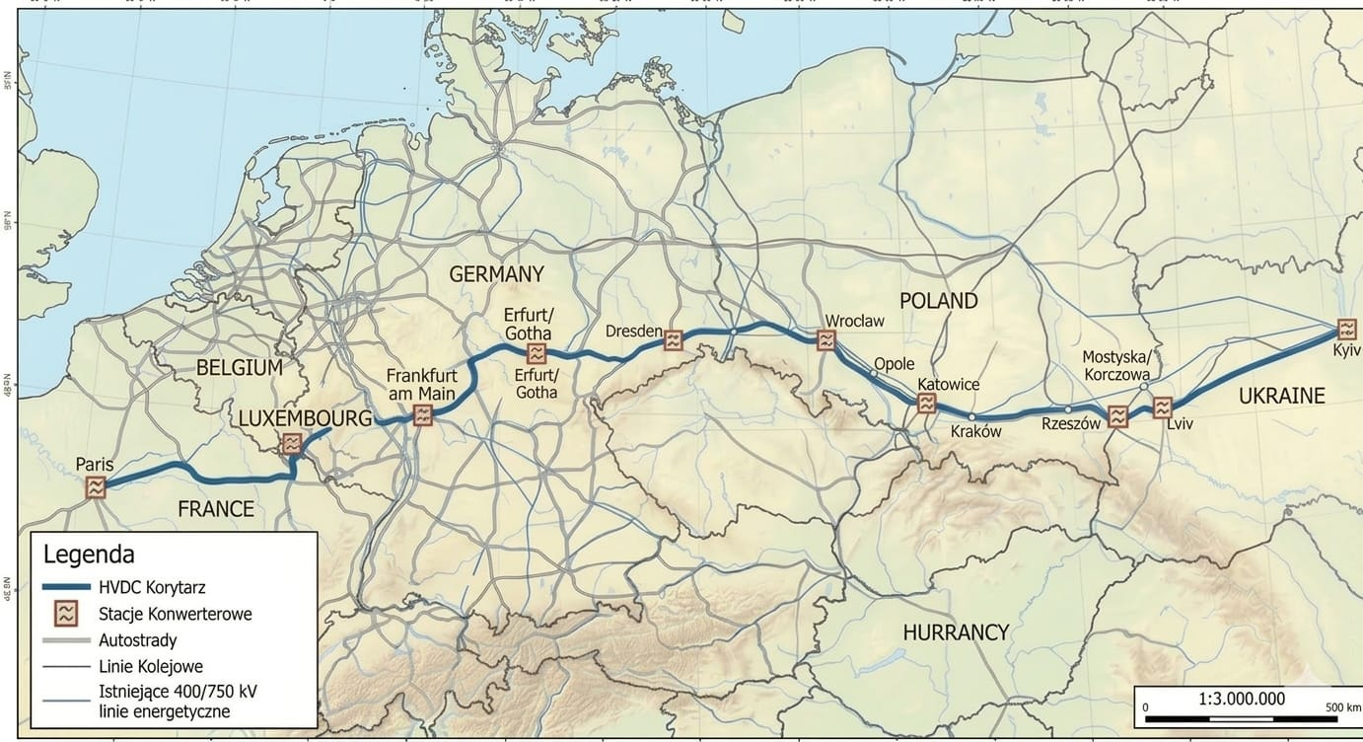
PEACE Grid Link:
This is a strategic initiative to maintain energy security in Central and Eastern Europe and to facilitate international electricity exchange.

Slide 3

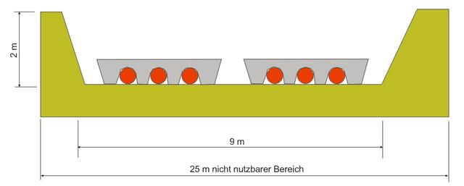

Safety on Cable Systems
Critical infrastructure
Higher security in attacks (drones)
Transmission networks are part of critical infrastructure and need protection
Cable systems are not visible due
to the surrounding soil and are therefore
particularly protected
Operational limitations and risks Thermal stress and attack risks can affect the reliability and safety of cable systems.

Slide 4
HVDC Routes
Direct current has above all the advantage that transmission losses in overhead lines are 30% to 50% lower than with alternating current. In addition, with the same route width, a connection with high-voltage direct current (HVDC) transmission can transmit two to three times more power. "Existing routes could thus be quickly converted into high-capacity power highways, which allows for faster implementation of grid expansion," says Dietmar Retzmann, HVDC expert at Siemens.
Additional costs are only offset again from a distance of 600 kilometers HVDC has a catch: Because power plants generate alternating current, the electricity must be converted for transport through expensive converters from alternating current (AC) to direct current (DC) and back to alternating current at the end.
The additional costs of 200 to 300 million euros for the converter stations, according to experts, are only offset by lower transmission costs from a distance of about 600 kilometers. At the same time, converter stations act as a firewall, as they block the cascading spread of disturbances in the power grid and can prevent a widespread propagation of blackouts.

Slide 5
Underground cables + energy storage = the backbone for grid stability
The two technologies play different roles, but only together do they make the grid 'war- and crisis-proof'
Here's how they interlock:
1. Underground cables = the "highway" for stability
What it can do:
Inertia: Long DC ground cables act like a huge capacitor. They smooth out voltage fluctuations.
Decouple regions: With HVDC you can connect UA, PL, DE, FR asynchronously. If the grid collapses in Kyiv, Paris doesn’t go down with it.
Sabotage-proof: Lies 1.5 meters underground. No storm, no ice, no drone attack can take it down.
What it CANNOT do:
React to load jumps in seconds. If suddenly 2 GW are missing, the cable takes 5-10 minutes to push more power.
2. Energy Storage = The 'Muscle' for Stability
What it can do:
0.1-second response: Batteries deliver full power in <100ms. Faster than any power plant.
Maintain frequency: At 49.9 Hz instead of 50 Hz, the storage shoots in 500 MW immediately. Prevents cascade failure.
Reactive power + voltage: Modern large-scale storage can also support voltage. Replace synchronous generators.

Slide 6
What it CANNOT do:
After 2-4 hours, the storage is empty. Without 'resupply' from the grid or cables, it’s worthless.
3. How things play out in 3 crisis scenarios
Scenario | Only underground cables | Only storage | Cables + storage
S1: Power plant goes offline - 2 GW | Frequency drops, load shedding after 10s | Storage absorbs 2 GW for 30 minutes. After that, blackout | Memories catch immediately. Cable adjusts in 2 minutes. No failure.
S2: Cable is cut | Section dead. Blackout | Memory keeps Region 4h alive | Bridge storage for 4h. Network operator can reschedule/redirect
S3: Cyberattack + Blackout | The network is dark, can't start | Storage systems can do a 'black start' | Battery starts island grid. Cable resynchronizes islands again
4. Conclusion in one sentence:
Underground cables prevent the grid from getting sick.Energy storage prevents it from dying if it does get sick.Without cables: storage is empty after 4 hours. Without storage: cables can't absorb shocks.That's why ENTSO-E and the EU Commission require in all 2025/2026 resilience plans: 'New strategic lines >1 GW must have at least 20% storage capacity.'

Slide 7
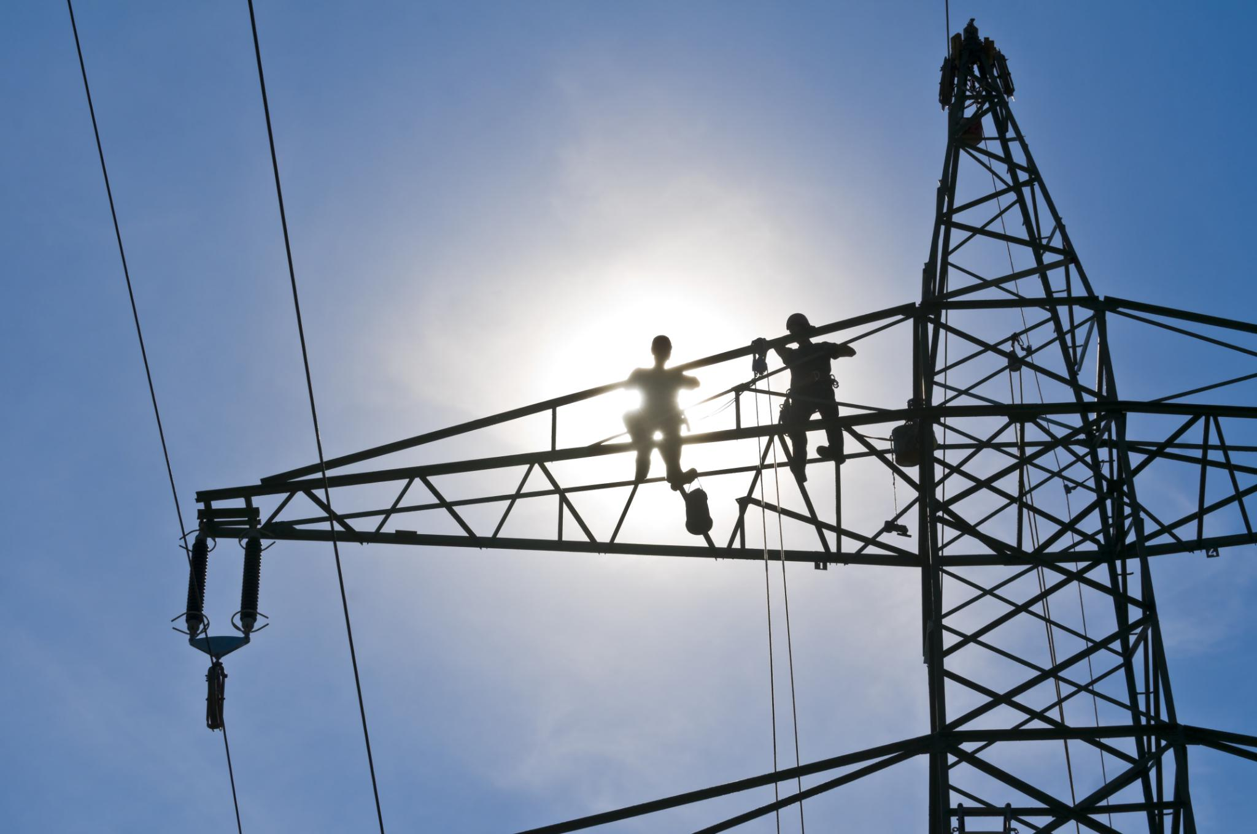

Overhead Lines
Cost-effectiveness
  Overhead power lines are cheaper to construct than underground cables due to lower material and civilwork costs.
Easy maintenance
  All components are easily accessible, making inspections and repairs quick and easy.
Quick fault diagnosis
  The open design allows for visual fault detection and precise measurement technology to enable rapid troubleshooting.
Flexibility and Durability
  Overhead lines can be easily extended and are highly resilient to fluctuations in temperature and load.

Slide 8
Overhead Lines
DISADVANTAGES
High susceptibility to weather conditions
  Storms, ice loads, and lightning strikes can damage overhead power lines and lead to power outages.
Visual Impairment
  Overhead power poles have a negative visual impact on the landscape and often provoke opposition from residents.
Increased Vulnerability to Disruption
  External factors such as falling branches or sabotage lead to damage and grid instability.
Restrictions in Urban Areas
  Safety distances and electromagnetic fields limit the use of adjacent areas in cities.
Security
  Overhead power lines pose a high risk of attacks (Drones)

Slide 9
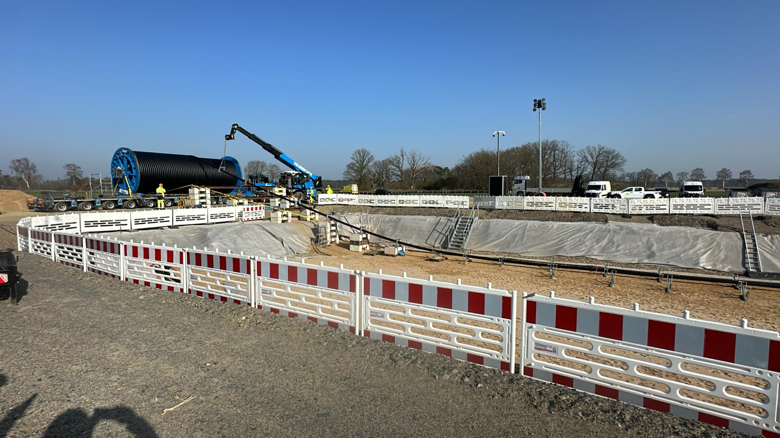
Cable routes
Advantages
Safety aspects
  Shielded cables offer high protection against external
  influences and ensure operational safety.
Efficient transmission
  Modern cable technologies ensure stable
  performance with lower losses, especially in
  regional grids.
Weather Resistance
  Underground cables are resistant to storms, ice buildup,
  and lightning strikes, which significantly reduces outages.
Landscape and environmental protection
  Underground cables avoid visual pollution and protect
  sensitive urban and natural areas.

Slide 10
Cable routes
DISADVANTAGES
High construction and installation costs
  Underground cables require extensive civil engineering work and specialized materials, which increases costs
Extensive repairs and fault location
  Repairs are time-consuming because cable damage must first be located using complex measurement procedures, and civil engineering work may be required.
Complicated permits and construction
  Soil conditions and existing infrastructure
  delay permits and construction work on the
  cable routes.

Slide 11
PEACE Grid Link Consortium:
The goal of the consortium is to guarantee stability, security, and reliability of electricity supply in cooperation with European partners and the European Union.
The current geopolitical and economic situation shows that without functioning energy networks, we cannot maintain the cohesion of societies in the long term.
PeaceLink is an important contribution to the future secure electricity supply in European countries. It advances market integration in Western and Eastern Europe and brings electricity to where it is needed. And that across borders.
It is all the more important to support projects like the PEACE Grid Link nationally and within the European Union in the interest of Europe.
Peace Grid Link Consortium Founders and Contributors
- Norbert Neumayer – CEO Xetra Infrastruktur /CEO, Peace Grid Link (www.xetra-infra.de, www.xetra-infra.pl, www.xetra-infra.com.ua)
- Robert Smolinski – Advisor to Professor Jerzey Buzek, Xetra Infrastruktur
- Adam Janicki – Expert in industrial project finance
- Marcin Kowcz – Energy sector expert (Poland and Germany)
- Frank Schiele – Senior executive with over 20 years of experience in HV cable projects
- Mirek Buchsteiner – Project manager with over 10 years of HV cable expertise

